Slide 1
FUNDAMENTALS
UNIT-1

Slide 2
CONTENTS:
String
Alphabet
Language
Operations
Finite State Machine
Definitions
Finite Automaton model
Acceptance of Strings & Languages
DFA transition diagrams and recognizers
NFA transition diagrams and recognizers

Slide 3
String:
A string over an alphabet ∑ is a Finite sequence of symbols of ∑.
Example: Let ∑ = {a,b} be an alphabet; then aa; ab; bba; baaba…………….
are some examples of strings over ∑.

Slide 4
Alphabet:
We formally define an alphabet as a non-empty finite set. We normally use the symbols letters/digits/any special symbols.
Example:
Letters: a, b, c……
Digits : 0,1
Special Symbols: +,-,(,),*,…..

Slide 5
Language:
Given an alphabet I, a language L is a set of strings, that is a subset of the universal language I.
Example:
a) The set of strings over 0’s and 1’s with equal number of each:{ɛ,01,10,0011,0101,1001,….}
b) The set of binary numbers whose value is a prime:{10,11,101,1011,………}

Slide 6
Operations:
On languages we can define the usual set operations that are.
union
intersection
complement

Slide 7
Operations:
Let L1 = {10} and L2 = {011, 11}.
Union: L1 ∪ L2 = {10, 011, 11}
Concatenation: L1 L2 = {10011, 1011}
Kleene Star: L1 * = {e, 10, 1010, 101010, … }

Slide 8
Finite State Machine:
The finite automata is a mathematical model of a system with discrete inputs and outputs.
The model consists of several states and transitions
At any time the state of the system summarizes the info concerning past inputs that is needed to determine the behavior of the system on subsequence inputs.

Slide 9
Finite State Machine:
The control mechanism of an elevator is a good example of FSM. This mechanism doesn’t remember all previous requests for service but only the current flow the direction of motion (up or down) and the collection of not yet satisfied requests for service.
Lexical Analyzer scans the symbols of a computer program to locate the string of characters corresponding to identifiers, constants and reserved words.

Slide 10
Finite Automaton:
Consists of a finite set of States and a set of transitions from a state to state that occur on input symbols chosen from an alphabet ∑.
A finite automaton is composed of five components:
1. Q: A finite set of states.
2. : A finite set of symbols, called the alphabet.
3. Q x --> Q is the transition function.
4. q0 in Q is the start state.
5. F is a set of final states (or accept states). F is a subset of Q.

Slide 11
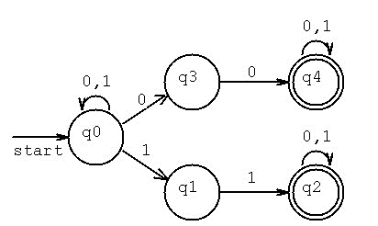
Transition diagram
A Directed Graph called a transition diagram is associated with a FA the vertices of the graph corresponds to the states of FA arcs labeled from one state to other state is called transition.

Slide 12
Transition table:
Transition table represents the transitions.
States | inputs
 | 0 | 1
q0 | q0, q3 | q0, q1
q1 | - | q2
q2 | q2 | q2
q3 | q4
q4 | q4 | q4

Slide 13
String Acceptance:
A String is said to be accepted by a FA M=(Q,∑,δ,q0,F) if δ(q0,x)=p for some p in F.
A language is accepted if all the strings generated from the language is accepted.
A language is said to be regular if it is the set accepted by a FA M.
Ex: δ(q0,111)= δ(δ(δ(q0,1),11)
= δ(δ(q0,1),1)
= δ(q1,1)
= q2 ϵ F
String is accepted

Slide 14
Finite Automaton Model:
The finite automaton model can be represented as
Input tape
↑Read head
a | b | a | b | B
Finite control

Slide 15
Finite Automaton Model:
Input tape: It is a linear tape having some cells which can hold an input symbol from ∑.
Finite control: It indicates the current state and decided the next state on receiving a particular input from the input tape.
Tape reader reads the cells one by one from left to right and at any instance only one input symbol is read.
The read head examines the symbol and head moves to the right side with or without changing the state .when the entire string is read and if finite control is in final state then the string is accepted otherwise rejected.

Slide 16
Finite Automata:
There are two types of finite automata
Deterministic Finite Automata
Non Deterministic Finite Automata

Slide 17
Deterministic Finite Automata:
In DFA, for each input symbol, one can determine the state to which the machine will move. Hence, it is called Deterministic Automaton. As it has a finite number of states, the machine is called Deterministic Finite Machine or Deterministic Finite Automaton.
Formal Definition of a DFA :
A DFA can be represented by a 5-tuple (Q, ∑, δ, q₀, F) where −
Q is a finite set of states.
∑ is a finite set of symbols called the alphabet.
δ is the transition function where δ: Q × ∑ → Q
q₀ is the initial state from where any input is processed (q₀ ∈ Q).
F is a set of final state/states of Q (F ⊆ Q).

Slide 18
Deterministic Finite Automata:
Example
Let a deterministic finite automaton be →
Q = {a, b, c},
∑ = {0, 1},
q₀ = {a},
F = {c}, and
Transition function δ as shown by the following table −

Slide 19
Transition table:
Transition table represents the transitions.
States | inputs
 | 0 | 1
a | a | b
b | c | a
c | b | c

Slide 20
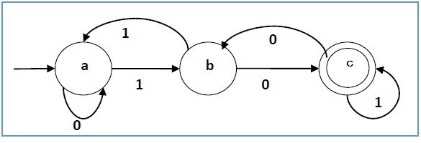
Transition diagram:

Slide 21
Non Deterministic Finite Automata:
In NDFA, for a particular input symbol, the machine can move to any combination of the states in the machine. In other words, the exact state to which the machine moves cannot be determined. Hence, it is called Non-deterministic Automaton. As it has finite number of states, the machine is called Non-deterministic Finite Machine or Non-deterministic Finite Automaton.

Slide 22
Non Deterministic Finite Automata:
Formal Definition of an NDFA:
An NDFA can be represented by a 5-tuple (Q, ∑, δ, q₀, F) where −
Q is a finite set of states.
∑ is a finite set of symbols called the alphabets.
δ is the transition function where δ: Q × ∑ → 2^{Q}
(Here the power set of Q (2^{Q}) has been taken because in case of NDFA, from a state, transition can occur to any combination of Q states)
q₀ is the initial state from where any input is processed (q₀ ∈ Q).
F is a set of final state/states of Q (F ⊆ Q).

Slide 23
Non Deterministic Finite Automata:
Example
Let a non-deterministic finite automaton be →
Q = {a, b, c}
∑ = {0, 1}
q₀ = {a}
F = {c}
The transition function δ as shown below −

Slide 24
Transition table:
Transition table represents the transitions.
States | inputs
 | 0 | 1
a | a, b | b
b | c | a, c
c | b, c | c

Slide 25
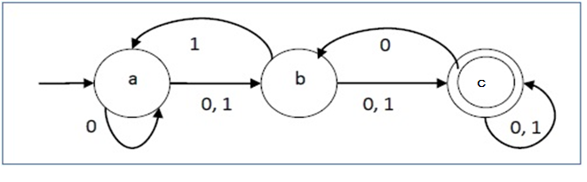
Transition diagram:

Slide 26
DFA vs. NDFA:
DFA | NDFA
The transition from a state is to a single particular next state for each input symbol. Hence it is called deterministic. | The transition from a state can be to multiple next states for each input symbol. Hence it is called non-deterministic.
Empty string transitions are not seen in DFA. | NDFA permits empty string transitions.
Backtracking is allowed in DFA | In NDFA, backtracking is not always possible.
Requires more space. | Requires less space.
A string is accepted by a DFA, if it transits to a final state. | A string is accepted by a NDFA, if at least one of all possible transitions ends in a final state.

Slide 27
DFA Examples:
Design a FA that accepts set of strings such that every string ends in 00,over alphabet ∑={0,1}.
Construct a FA that accept set of strings where the number of 0’s in every string is multiple of three over alphabet ∑={0,1}.
Design a FA which accepts set of strings containing exactly four 1’s in every string over alphabet ∑={0,1}.
Design a FA that accept strings containing exactly one 1 over alphabet ∑={0,1}.
Design a FA which accept the language
L={ω ϵ (0,1)*/second symbol of ω is ‘0’ and fourth input is 1}.
6. Give a DFA for Σ = {0, 1} and strings that have an odd number of 1’s and any number of 0’s.
7. Give a DFA for Σ = {a, b, c} that accepts any string with aab as a substring.
8. Give a DFA for Σ = {a, b} that accepts any string with aababb as a substring.

Slide 28
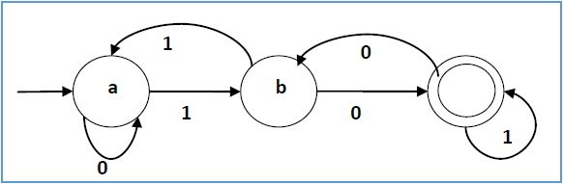
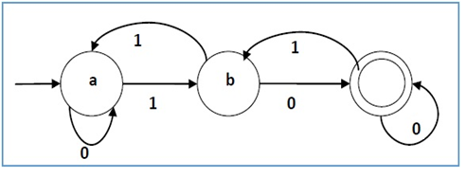
DFA Examples:
For the given FA write the language and also give the transition table.
10. For the given FA write the language and also give the transition table.

Slide 29
DFA Examples:
Design FA for the language
L={(01)^{i} (1)^{2i} / i>=1}.
Design a FA over alphabet ∑={0,1},which accept the set of strings either start with 01 or end with 01.
Give the DFA accepting the set of strings over alphabet ∑={0,1},such that in each string number of 0’s is divisible by five and number of 1’s is divisible by 3.
Design a FA which accept the language L={ω /ω has both an even number of 0’s and an even number of 1’s over alphabet ∑={0,1}.

Slide 30
NFA Examples:
Design a NFA for the language L=all string over {0,1} that have at least two consecutive 0’s or 1’s.
2. Draw the state diagram for NFA accepting language L=(ab)*(ba)* U aa*.
Draw the state diagram for NFA accepting language L=(aba)* U aa*.
Draw the state diagram for NFA accepting language L={(a^{n}:n>=0) U (b^{n}a:n>=1)}.
5. Draw the state diagram for NFA accepting language L= ={(a^{n}:n>=0) U (b^{n}:n>=0)}.

